Slide 1
Methods for analysis of EEG data
Project II

Slide 2
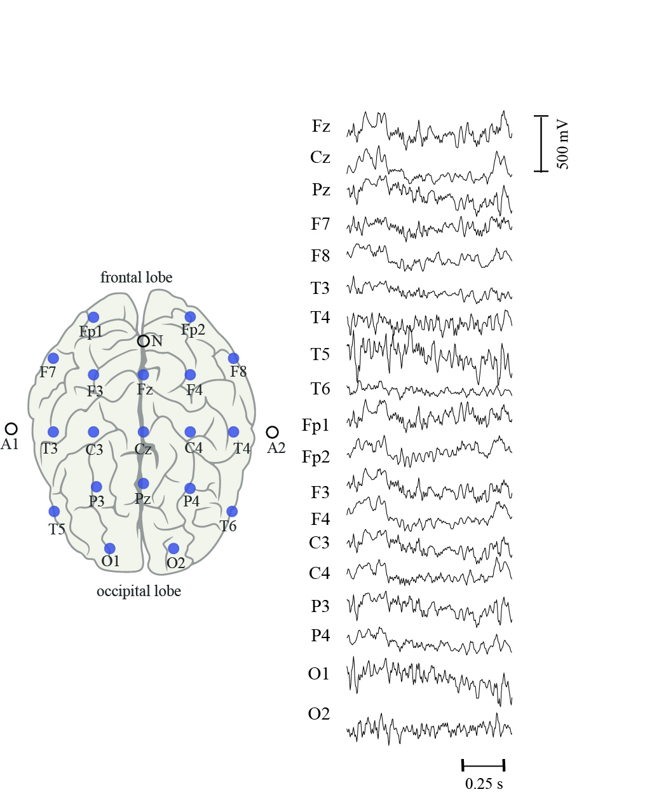
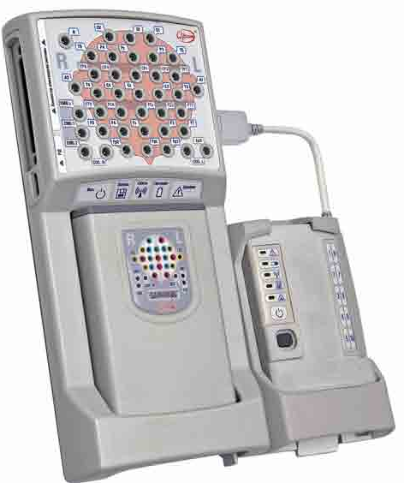
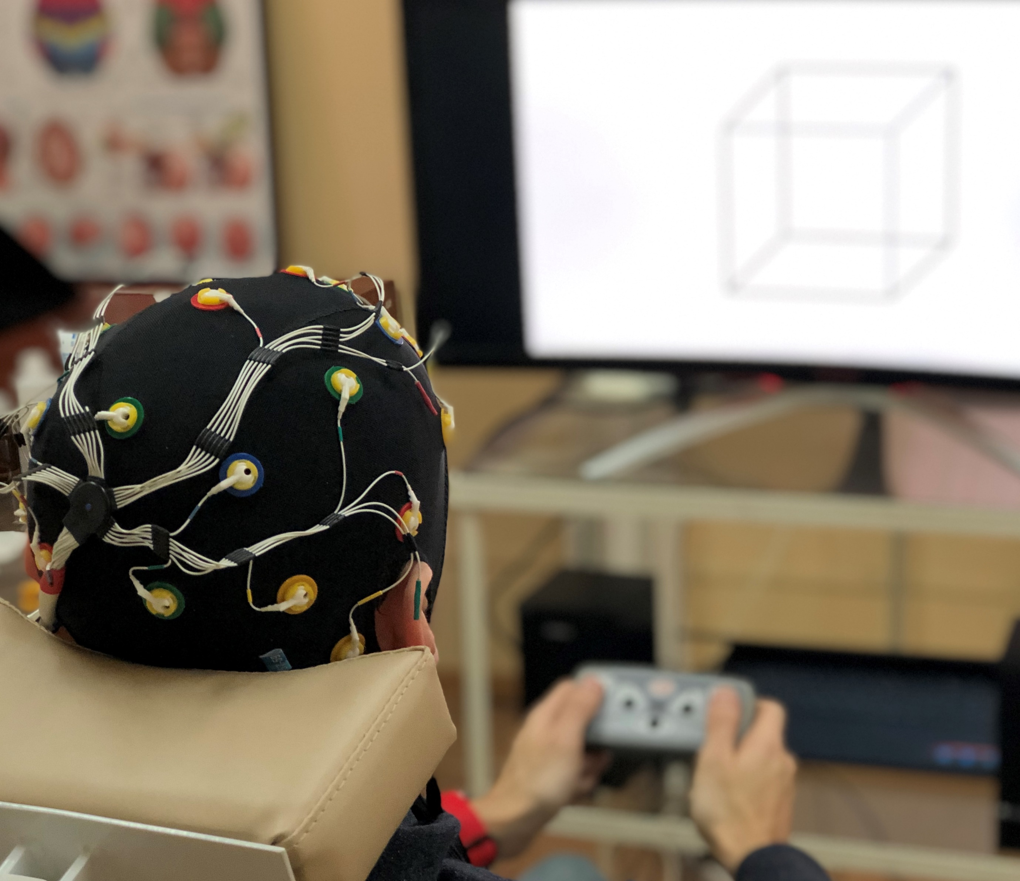
Electroencephalography
Electroencephalography (EEG) is an electrophysiological monitoring method to record electrical activity of the brain. It is typically noninvasive, with the electrodes placed along the scalp with a conductive gel or paste, usually after preparing the scalp area by light abrasion to reduce impedance due to dead skin cells.
EEG measures voltage fluctuations resulting from ionic current within the neurons of the brain.
Electrode locations and names are specified by the International 10–20 system (19 recording electrodes + ground and system reference)

Slide 3
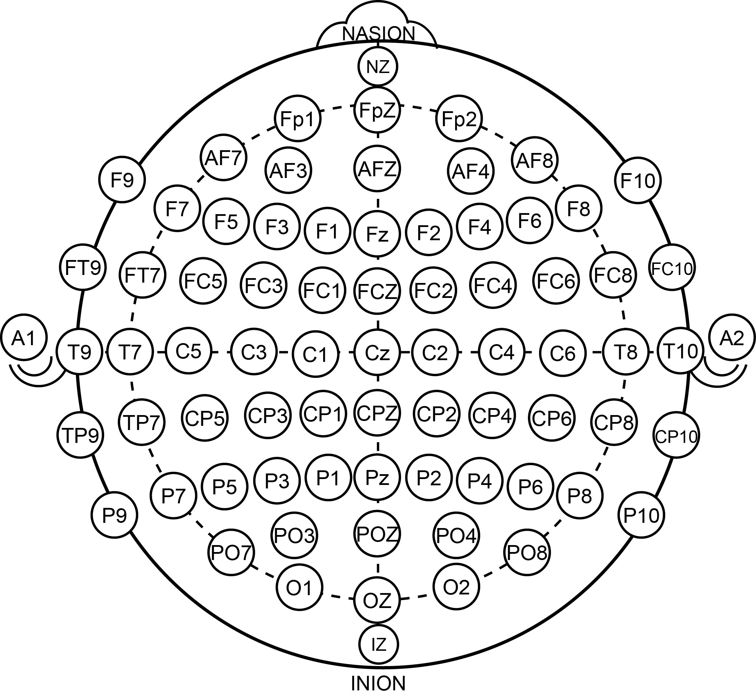
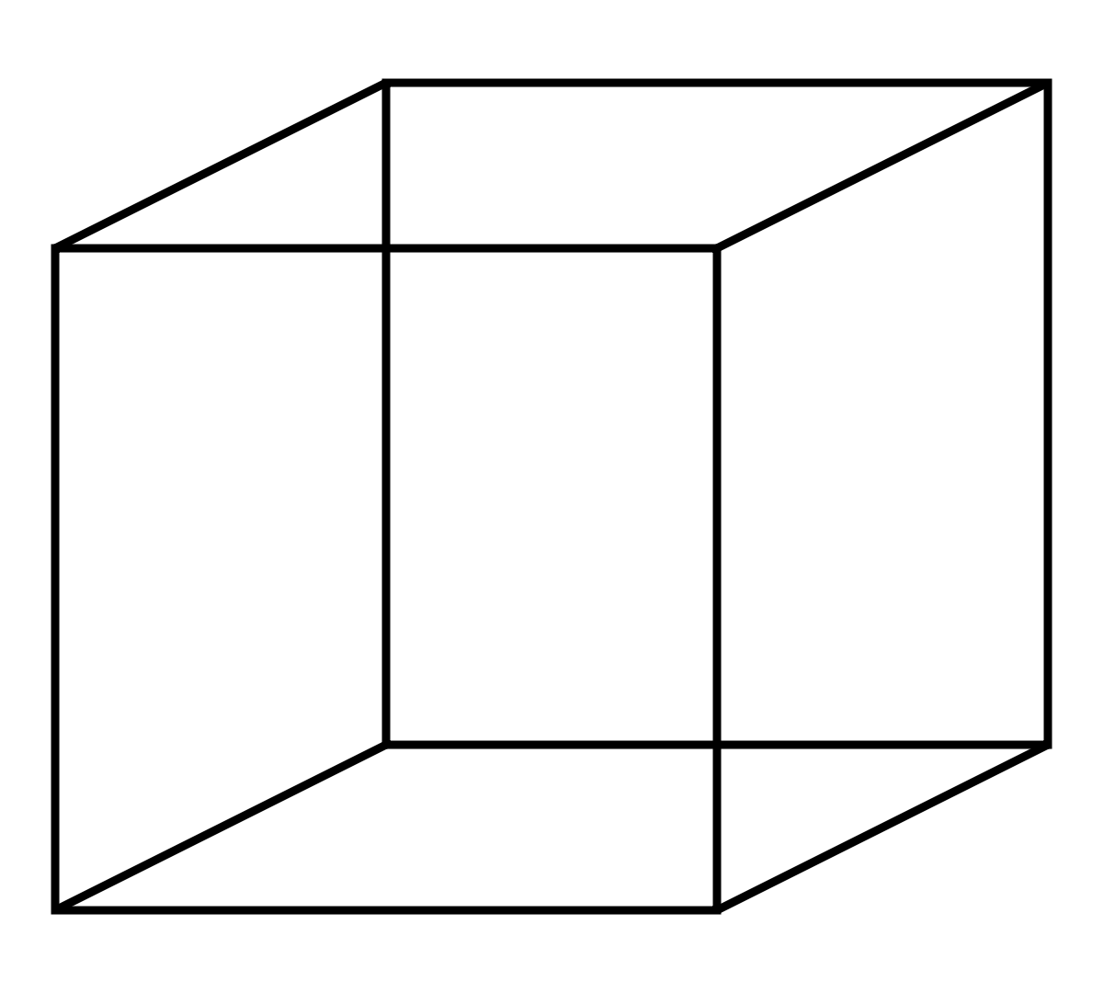
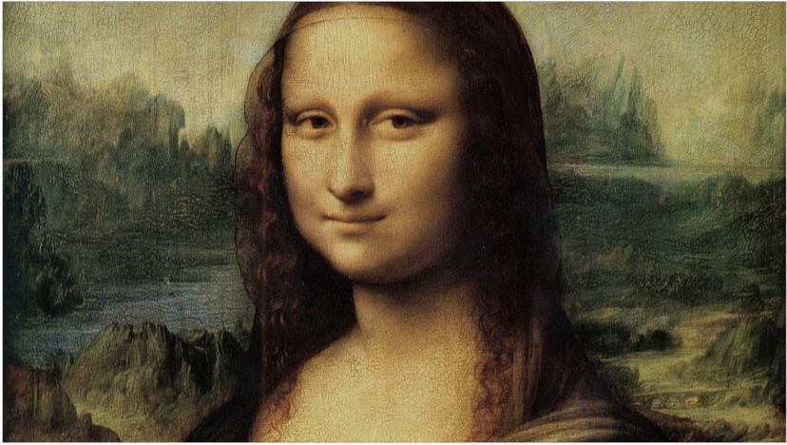
EEG data
1. O2-A2
2. O1-A1
3. P4-A2
4. P3-A1
5. C4-A2
6. C3-A1
7. F4-A2
8. F3-A1
9. Fp2-A2
10. Fp1-A1
11. T6-A2
12. T5-A1
13. T4-A2
14. T3-A1
15. F8-A2
16. F7-A1
17. Oz-A2
18. Pz-A1
19. Cz-A2
20. Fz-A1
21. Fpz-A2
22. FT7-A1
23. FC3-A1
24. Fcz-A1
25. FC4-A2
26. FT8-A2
27. TP7-A1
28. CP3-A1
29. Cpz-A1
30. CP4-A2
31. TP8-A2
31 electrodes + 3 referents
EEG recording sampling rate 250Hz
2 data sets: Necker cubes and Mona Lisa portraits
5 participants each

Slide 4
Methods
Pearson correlation – https://en.wikipedia.org/wiki/Pearson_correlation_coefficient
Recurrence measure of dependence (RMC) – http://nctech-lab.ru/Content/ArticleImages/34080920-c87e-42a3-8258-e0fe94ccd309.pdf
Wavelet bicoherence (WB) – http://nctech-lab.ru/Content/ArticleImages/48473239-2046-436e-ad0e-93d55605200c.pdf
Artificial neural network (ANN) – http://nctech-lab.ru/Content/ArticleImages/e52c57ec-2f83-463a-b61c-57fb9900d414.pdf
Statistical analysis – Nonparametric Test
Data sets:
Necker cubes
Mona Lisa portraits

Slide 5
Project II
Necker Cube – Correlation, Recurrence measure of dependence, Statistical analysis
Necker Cube – Correlation, Artificial neural network, Statistical analysis
Necker Cube – Correlation, Wavelet bicoherence, Statistical analysis
Mona Lisa portrait – Correlation, Recurrence measure of dependence, Statistical analysis
Mona Lisa portrait – Correlation, Artificial neural network, Statistical analysis
Mona Lisa portrait – Correlation, Wavelet bicoherence, Statistical analysis
Necker Cube + Mona Lisa portrait – Correlation (for one person)

Slide 6
Task
Investigation of the methods (what is the method doing, how can you use it, etc.)
Implementation of the methods to the data:
Using correlation and RMC/WB/ANN to estimate the connections between different EEG channels in α (8-12 Hz) and β (15-30 Hz) frequency regions for different values of brightness intensity I∈(0.1-1.0), finding an optimal value of I for each subject characterized by maximal connectivity
Estimating efficiency of Pearson correlation and RMC/WB/ANN
Investigation of the time-dependence of the coupling strength, finding an optimal value of time window for calculation of the coupling strength
Using a Nonparametric Test for checking a hypothesis of achieving maximal connectivity in the found range of the optimal brightness intensity
Writing a report

